Slide 1
User Analytics in the Telecommunication Industry
Name : Meenakshi Gupta

Slide 2
Objectives
Business Needs
User Overview analysis
User Engagement analysis
User Experience analysis
User Satisfaction Analysis
Top Satisfied Customers
Model Building
Model Deployment

Slide 3
Objectives and Business Need
Your employer wants you to provide a report to analyze opportunities for growth and make a recommendation on whether TellCo is worth buying or selling. You will do this by analyzing a telecommunication dataset that contains useful information about the customers & their activities on the network. You will deliver insights you managed to extract to your employer through an easy-to-use web-based dashboard and a written report.
The investor is interested in purchasing TellCo, an existing mobile service provider in the Republic of Pefkakia. TellCo’s current owners have been willing to share their financial information but have never employed anyone to look at their system-generated data.

Slide 4
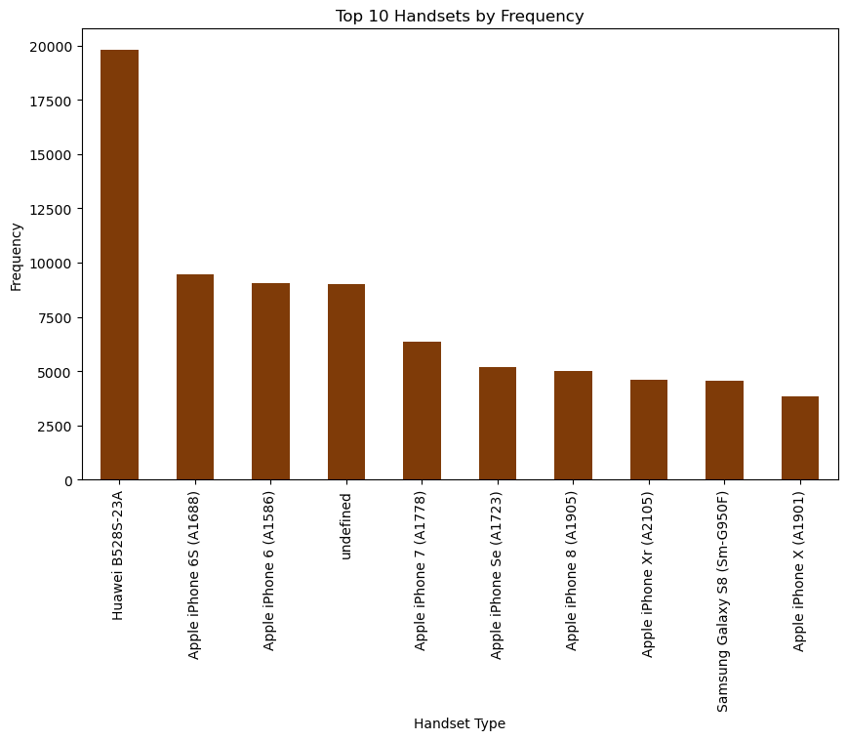
User Overview analysis
Top 10 handsets used by the customers
frequency of different handset types: The most common handset type is Huawei B5285-23A, followed by Apple iPhone 6S (A1688) and Apple iPhone 6 (A1586). The least common handset type is Apple iPhone X (A1901).
Marketing and promotions: Target marketing campaigns to the most popular devices.
Product development: Prioritize support for devices that are used by the majority of customers.
Network planning: Optimize network capacity to handle the traffic from the most popular devices.
Customer service: Focus on providing support for the devices that are most likely to be used by customers.

Slide 5
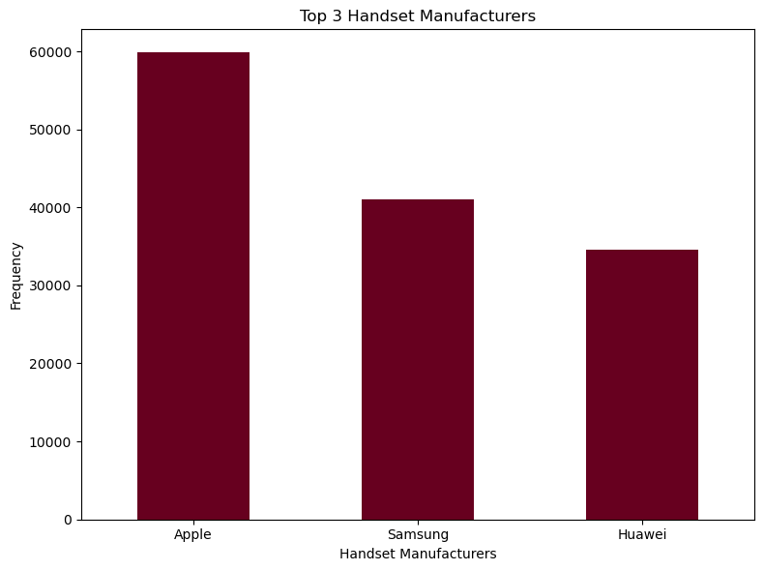
Top 3 handset manufacturers
Focus on Apple Users: Since Apple leads in terms of handset users, ensure compatibility with Apple devices, iOS updates, and specific support for Apple services (iCloud, FaceTime, etc.).
Strong Support for Samsung: Samsung devices are also prominent, meaning ensuring Android compatibility, especially with Samsung's custom features and software versions, is crucial.
Consider Huawei Users: Given Huawei’s unique software ecosystem (especially post-Google services restrictions), it’s important to provide dedicated support and updates for these devices.
Device-Specific Services: Consider launching device-specific services or promotions targeting these manufacturers based on the trends in their user behaivior and needs.

Slide 6
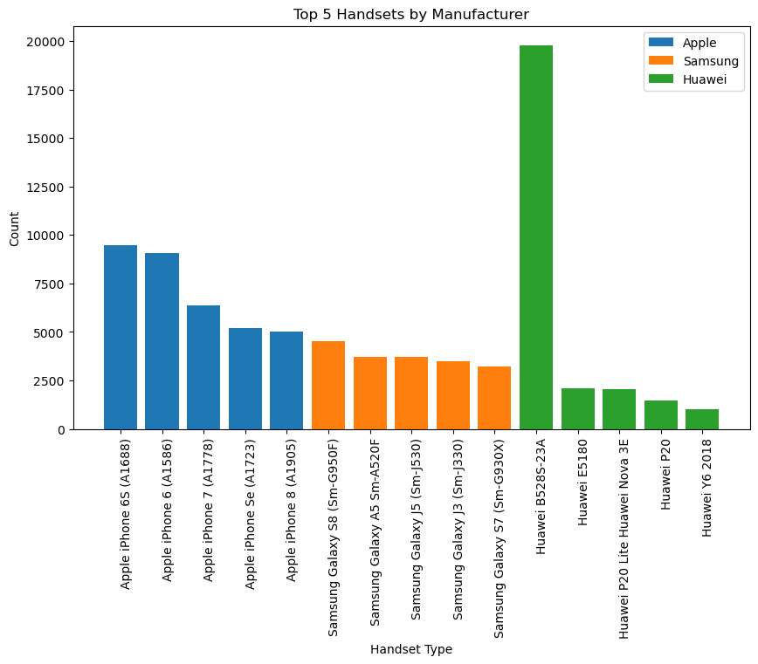
Top 5 Handsets by Manufacturer
Product development: Marketing teams can use this data to identify which handsets are most popular with consumers and focus on developing new products or features that meet those needs.
Marketing campaigns: This data can also be used to target marketing campaigns more effectively. For example, if a company is promoting a new smartphone, they could target their ads to users of the most popular handsets.
Sales and distribution: By understanding which handsets are in high demand, marketing teams can better manage their sales and distribution channels.
Target specific models: The chart shows that certain models are more popular than others. Marketing teams should focus on promoting the most popular models.
Consider Huawei: Huawei is a rising competitor and may be worth targeting in specific markets.

Slide 7
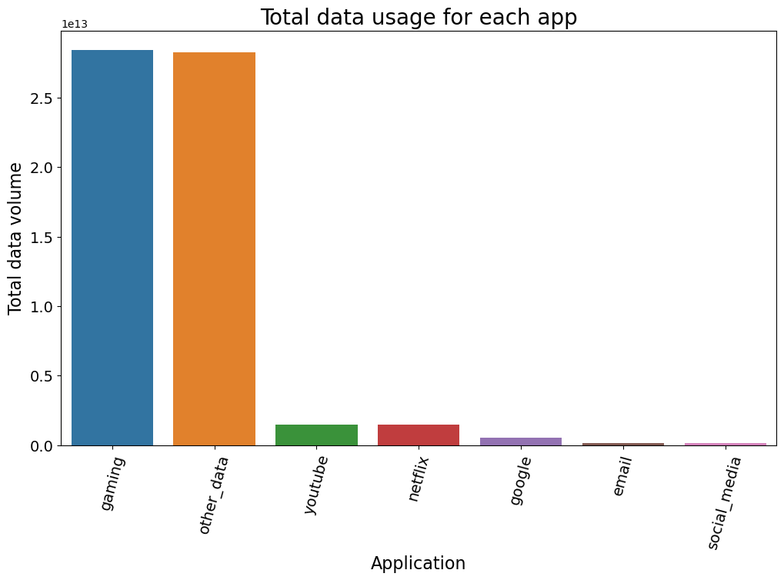
Total data usage for each app
This bar chart shows the total data usage for different applications. The largest data usage is for gaming, followed by other_data, youtube, netflix, google, email, and social_media. The amount of data used by gaming is significantly higher than other applications. This graph shows that gaming and other_data usage contribute significantly to the total data usage.

Slide 8
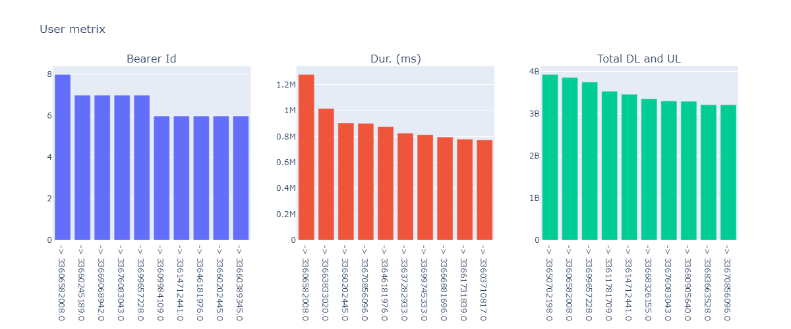
Now , Count the number of sessions users have using Bearer Id and sum their total duration and total data usage.
The charts show that there is a wide range of user experiences across the different bearer IDs, in terms of the number of users, duration, and total data usage. This information can be used to identify areas where user experience can be improved.

Slide 9
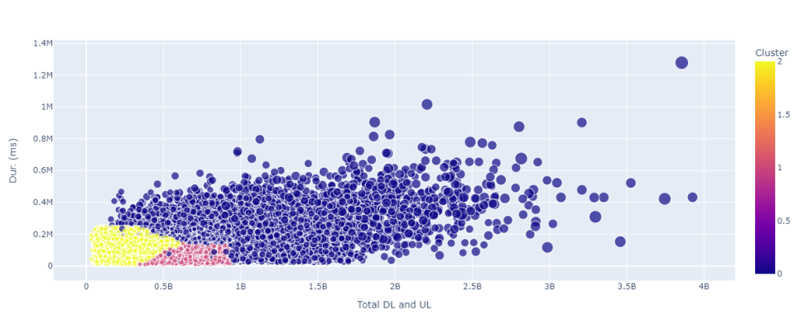
Normalize each engagement metric and run a k-means (k=3) to classify customers into three groups of engagement.
The blue cluster is the largest and occupies the majority of the space in the plot, while the pink and yellow clusters are smaller and appear concentrated in the bottom left corner of the plot. The blue cluster has more data points, and those points are more spread out compared to the other clusters, whereas the yellow and pink clusters are tightly packed. The plot also shows that the blue cluster has a higher average value for both "Total DL and UL" and "Dur. (ms)" compared to the other clusters.

Slide 10
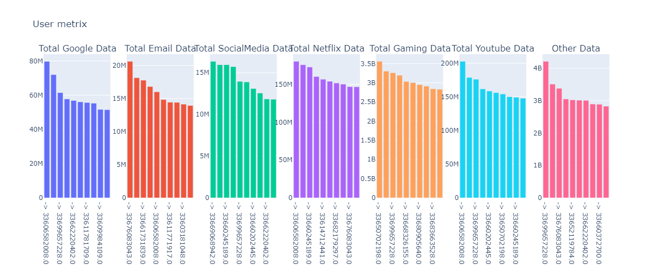
Top 10 most engaged users per application
This bar chart comparing the amount of data consumed by different internet services. It shows that the largest amount of data was consumed through Google services, followed by other data, email, and social media. The smallest amount of data was consumed by Netflix services.

Slide 11
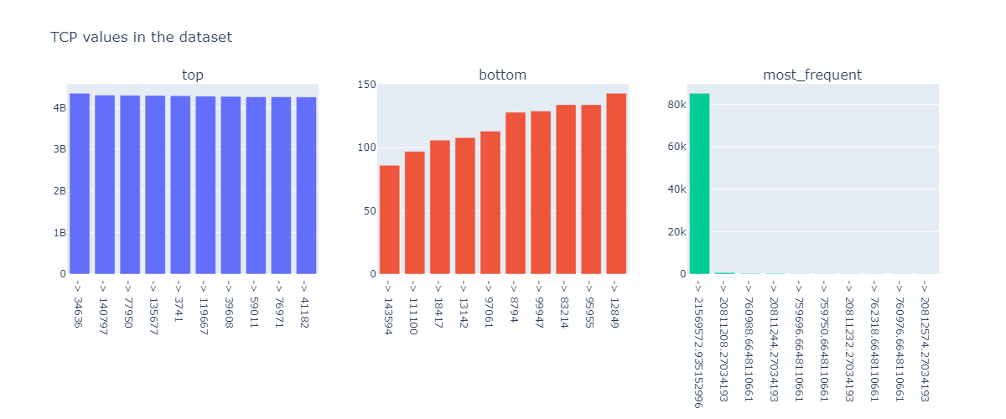
Top 10 TCP values in the dataset
The top values are a list of the highest 10 TCP values, while the bottom values are the lowest 10. The most frequent values show the count of each unique TCP value, with the most frequent TCP values at the top of the chart.

Slide 12
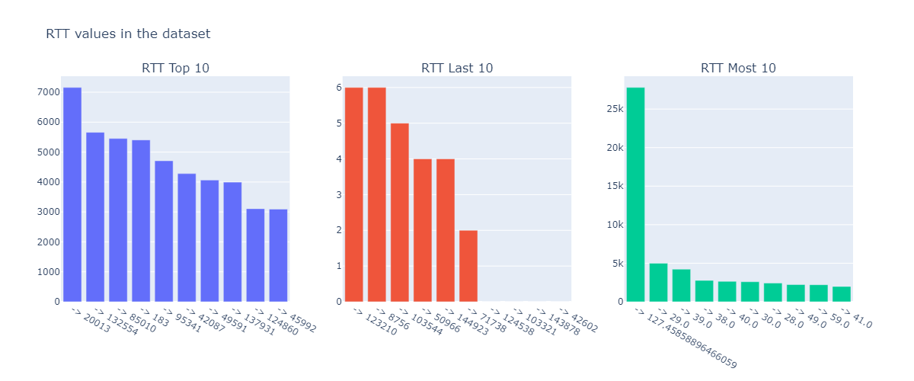
Top 10 RTT values in the dataset
These charts provide insights into the distribution of RTT values in the dataset. For example, the "RTT Top 10" chart highlights the outliers with the highest RTT values, while the "RTT Most 10" chart shows the values that occur most frequently. This information can be useful for identifying potential issues or trends related to network performance.

Slide 13
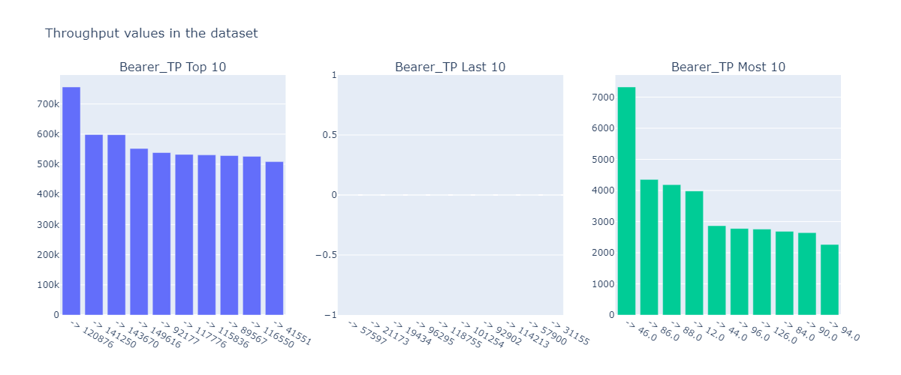
Top 10 Throughput values in the dataset
The leftmost plot shows the top 10 values, with the highest value being around 750k. The rightmost plot shows the most frequent values, with the highest frequency being around 7,500. The middle plot shows the last 10 values, with the values being very low.

Slide 14
Satisfaction Analysis
Objective:
Unlock the Secrets of User Happiness in Telecom
Uncover the Key Drivers of User Satisfaction
Importance:
Integrate engagement metrics (session frequency, duration, total traffic) and experience metrics (TCP retransmission, Round Trip Time, throughput) to identify the most influential factors impacting user contentment.
Why it Matters:
User satisfaction is the backbone of business success, directly influencing loyalty, recommendations, and brand perception.
Analyzing satisfaction provides actionable insights for refining services, optimizing networks, and retaining customers.
In today's competitive telecom landscape, service quality and user experience are crucial for staying ahead of the curve.
User satisfaction is a strategic asset that shapes service customization and maintains competitiveness.

Slide 15
Next Steps:
Satisfaction Analysis Roadmap:
Compute satisfaction scores
Identify top-performing users
Apply regression modeling
Perform clustering
Extract actionable insights
Inform Strategic Decisions:
Use insights to drive strategic decisions that enhance user satisfaction
Additional Focus: Comprehensive Understanding:
Emphasize engagement metrics (session frequency, duration, total traffic) and experience metrics (TCP retransmission, Round Trip Time, throughput) to gain a deeper understanding of user satisfaction.

Slide 16
Growth potential of the company
Market Dominance of Key Players
The data highlights the substantial market presence of industry giants such as Apple, Samsung, and Huawei, demonstrating their significant influence on consumer preferences. This emphasizes the need for businesses to align their marketing strategies with these key players in order to leverage their market influence effectively.
Application Usage Insights
An examination of the top three most frequently used applications reveals the significance of accommodating data-intensive activities, such as gaming, in order to meet user demands. Additionally, the diverse range of applications within the "Other" category should not be overlooked. By analyzing these usage patterns, targeted promotions and network optimizations can be developed to enhance user satisfaction.

Slide 17
Conclusion
The analysis suggests that TellCo's telecom business has promising opportunities for growth and optimization. By harnessing the insights provided, the marketing team can make informed decisions regarding:
Strategic investments that drive business growth
Resource allocation that maximizes efficiency
Customer-centric initiatives that enhance user experience and loyalty
These data-driven decisions can ultimately drive profitability and competitive advantage in the telecommunications industry.

Slide 18
Driving Growth and Optimization in TellCo's Telecom Business
The analysis provides a wealth of insights that can be leveraged to drive growth and optimization in TellCo's telecom business. By harnessing these insights, the marketing team can make informed decisions that have a direct impact on the company's bottom line.
Competitive Advantage
Ultimately, the insights provided by the analysis can help TellCo drive profitability and competitive advantage in the telecommunications industry. By making data-driven decisions, TellCo can stay ahead of the competition and establish itself as a leader in the market. This could include developing innovative new products and services, or identifying new revenue streams that drive business growth.

Slide 19


